Slide 1
Introduction to Machine Learning
Dai Bui

Slide 2





What is Machine Learning?
Input $x$
Real world object
Output $y$
Such that $\left\|\hat{y}−y\right\|$ is very small
Input $x$
Learning Machine
Output $\hat{y}$
This is called supervised learning
The Machine learns the internal (invisible) states of the real world object through the observation of the behaviors of the object

Slide 3
What is Machine Learning?
Why do we need to find the function?

Slide 4
What is Machine Learning?
No previous outcome is given. The machine needs to learn the structure
by themselves: Unsupervised learning

Slide 5
Machine Learning Phases
It is composed of two phases
Training
Validation
Training
Inputs are fed into the learning machine
The parameters of the learning machine are tune so that the predicted outputs are close to the target outputs
Similar to homework practicing for students
Validation
Some of the data samples are retained and not used during training
Use the retained samples to test if the learned machine can predict close to the target values of the retained samples when fed with the retained input samples
Can be thought as exams for students

Slide 6
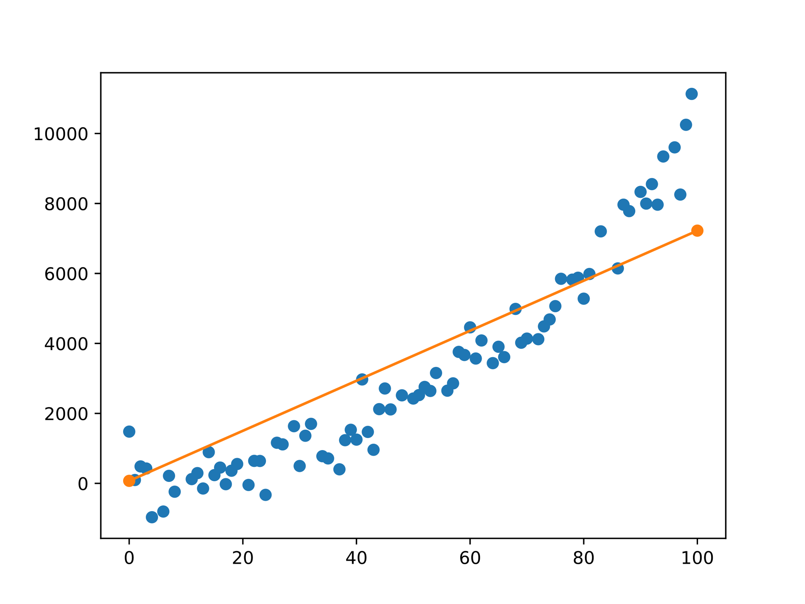
Linear Regression

Slide 7

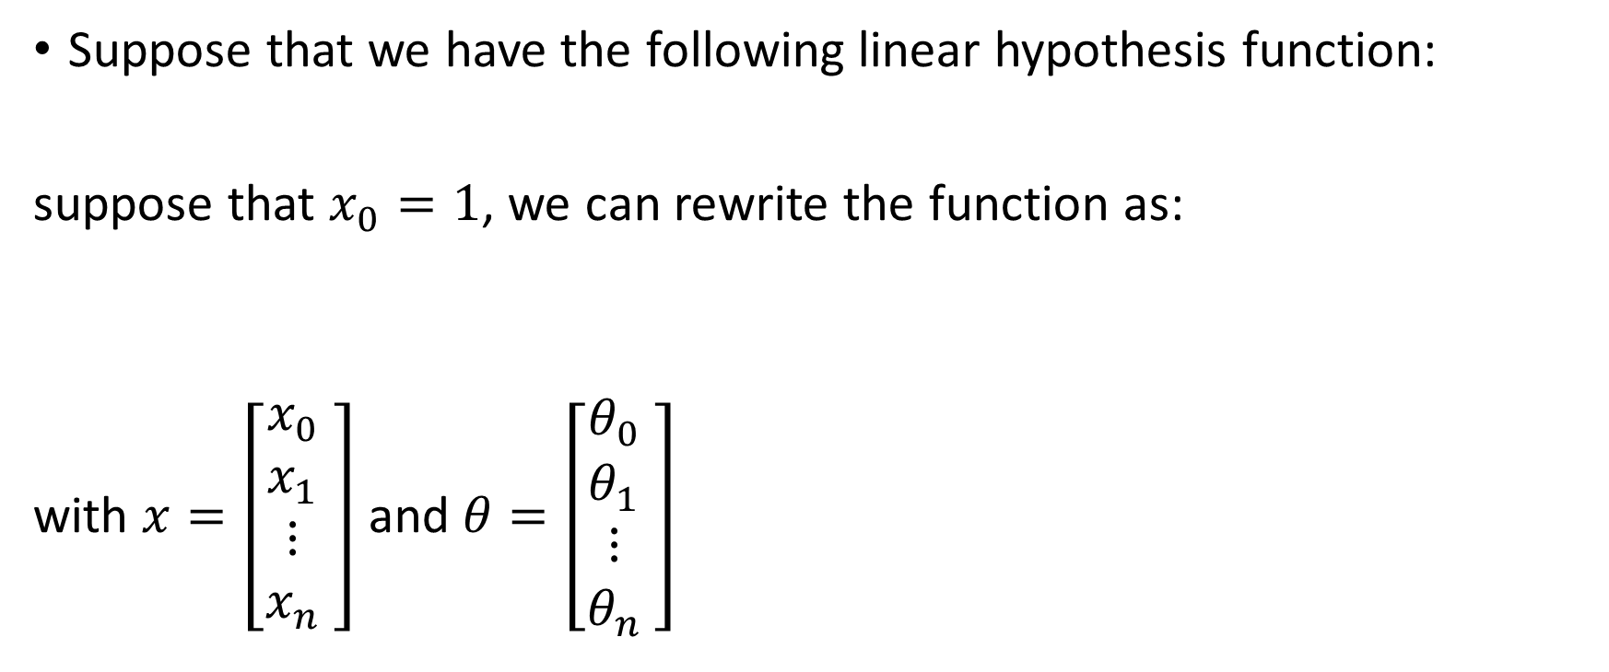

Linear Regression
Suppose that we have the following linear hypothesis function:
suppose that $x_{0}=1$, we can rewrite the function as:
with $x=\left[\begin{matrix}x_{0} \\ x_{1} \\ \begin{aligned}⋮ \\ x_{n}\end{aligned}\end{matrix} \right]$ and $θ=\left[\begin{matrix}θ_{0} \\ θ_{1} \\ \begin{aligned}⋮ \\ θ_{n}\end{aligned}\end{matrix} \right]$
$$h_{θ}\left(x\right)=θ_{0}+θ_{1}x_{1}+θ_{2}x_{2}$$
$$h_{θ}\left(x\right)=\sum_{i=0}^{n}{θ_{i}x_{i}}=θ^{T}x$$

Slide 8
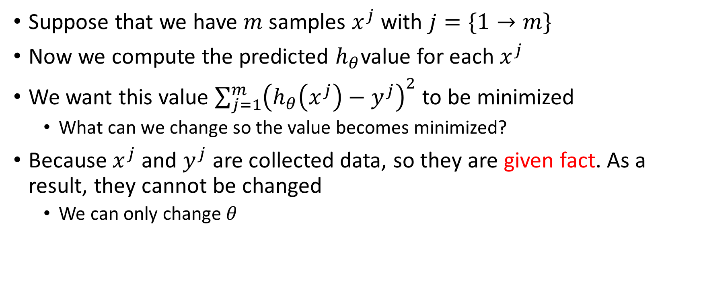
Loss Function
Suppose that we have $m$ samples $x^{j}$ with $j=\{1→m\}$
Now we compute the predicted $h_{θ}$value for each $x^{j}$
We want this value $\sum_{j=1}^{m}{{\left(h_{θ}\left(x^{j}\right)−y^{j}\right)}^{2}}$to be minimized
What can we change so the value becomes minimized?
Because $x^{j}$ and $y^{j}$ are collected data, so they are given fact. As a result, they cannot be changed
We can only change $θ$

Slide 9
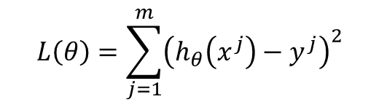


Loss Function
We define the following loss function as a function of $θ$:
We will find $θ^{∗}$ such that $L(θ^{∗})$ is smallest:
How do we find such $θ^{∗}$?
$$L\left(θ\right)=\sum_{j=1}^{m}{{\left(h_{θ}\left(x^{j}\right)−y^{j}\right)}^{2}}$$
$$θ^{∗}=arg\min_{θ}{L\left(θ\right)}$$

Slide 10
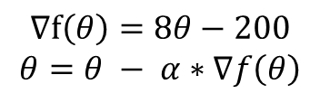

Gradient Descent
Let us take an example: Find $θ$ such that $f\left(θ\right)=4θ^{2}−200θ+50$ is smallest:
$α$ is called the learning rate
When do we stop?
$$∇f\left(θ\right)=8θ−200$$
$$θ=θ − α∗∇f\left(θ\right)$$

Slide 11
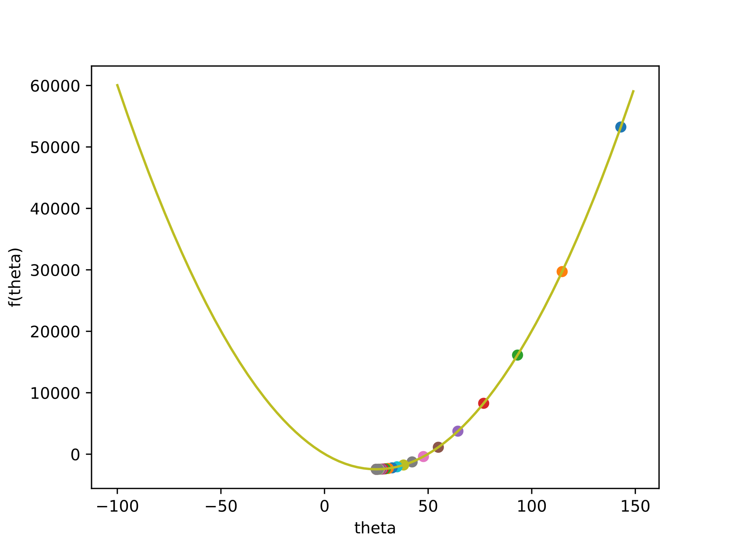
Gradient Descent Coding

Slide 12
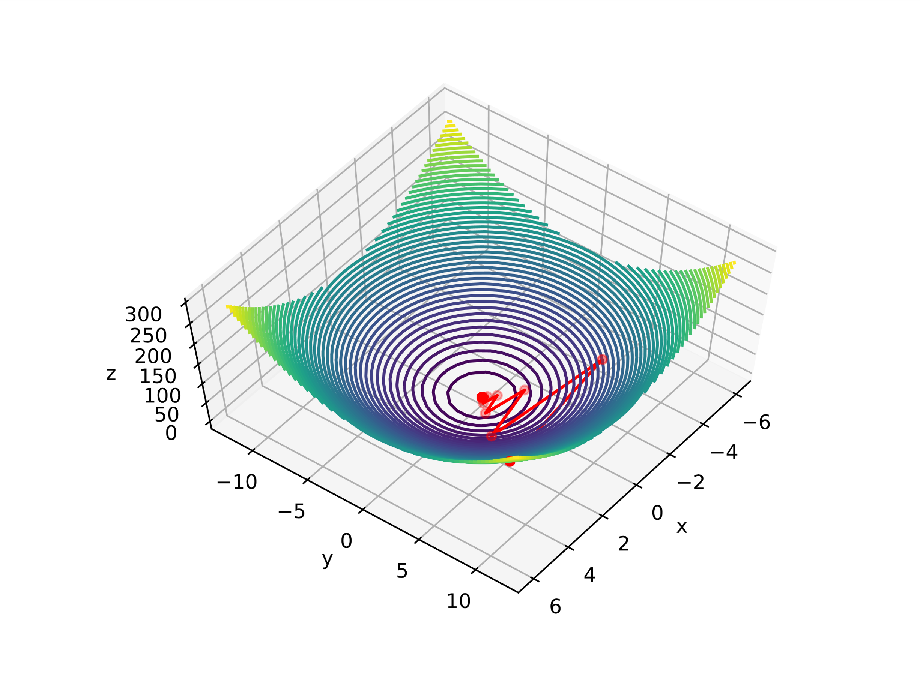
Multivariate Gradient Descent

Slide 13
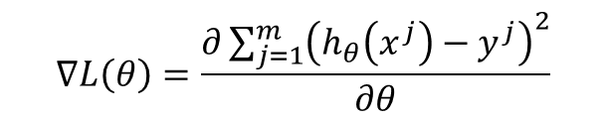


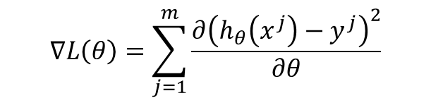
Gradient Descent for Linear Regression Loss Function
$$∇L\left(θ\right)=\frac{∂\sum_{j=1}^{m}{{\left(h_{θ}\left(x^{j}\right)−y^{j}\right)}^{2}}}{∂θ}$$
Because this is a function of $θ$, we have:
According to the matrix derivation we have:
$$∇L\left(θ\right)=\sum_{j=1}^{m}{\frac{∂{\left(h_{θ}\left(x^{j}\right)−y^{j}\right)}^{2}}{∂θ}}$$
$$\frac{∂{\left(h_{θ}\left(x^{j}\right)−y^{j}\right)}^{2}}{∂θ}=\left[\begin{aligned}\begin{matrix}\frac{∂{\left(h_{θ}\left(x^{j}\right)−y^{j}\right)}^{2}}{∂θ_{0}} \\ \frac{∂{\left(h_{θ}\left(x^{j}\right)−y^{j}\right)}^{2}}{∂θ_{1}} \\ ⋮\end{matrix} \\ \frac{∂{\left(h_{θ}\left(x^{j}\right)−y^{j}\right)}^{2}}{∂θ_{n}}\end{aligned}\right]$$

Slide 14
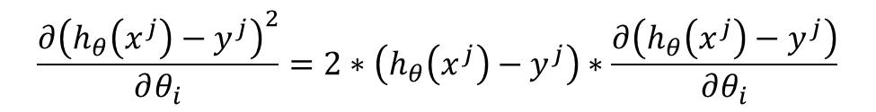
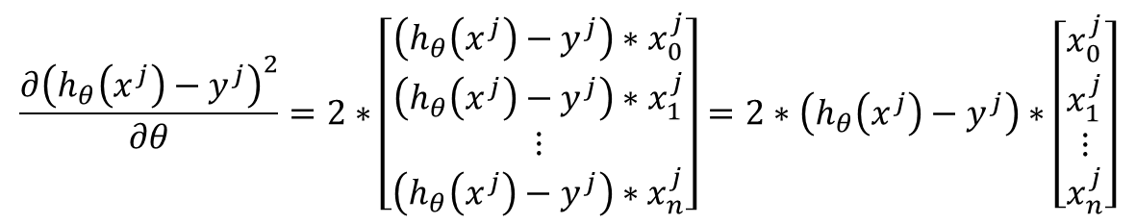
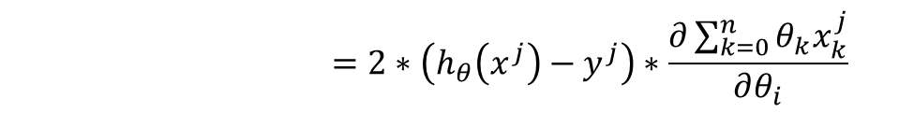
Gradient Descent for Linear Regression Loss Function
So we have:
$$\frac{∂{\left(h_{θ}\left(x^{j}\right)−y^{j}\right)}^{2}}{∂θ_{i}}=2∗\left(h_{θ}\left(x^{j}\right)−y^{j}\right)∗\frac{∂\left(h_{θ}\left(x^{j}\right)−y^{j}\right)}{∂θ_{i}}$$
$$=2∗\left(h_{θ}\left(x^{j}\right)−y^{j}\right)∗\frac{∂\sum_{k=0}^{n}{{θ_{k}x}_{k}^{j}}}{∂θ_{i}}$$
$$=2∗\left(h_{θ}\left(x^{j}\right)−y^{j}\right)∗x_{i}^{j}$$
$$\frac{∂{\left(h_{θ}\left(x^{j}\right)−y^{j}\right)}^{2}}{∂θ}=2∗\left[\begin{aligned}\begin{matrix}\left(h_{θ}\left(x^{j}\right)−y^{j}\right)∗x_{0}^{j} \\ \left(h_{θ}\left(x^{j}\right)−y^{j}\right)∗x_{1}^{j} \\ ⋮\end{matrix} \\ \left(h_{θ}\left(x^{j}\right)−y^{j}\right)∗x_{n}^{j}\end{aligned}\right]=2∗\left(h_{θ}\left(x^{j}\right)−y^{j}\right)∗\left[\begin{aligned}\begin{matrix}x_{0}^{j} \\ x_{1}^{j} \\ ⋮\end{matrix} \\ x_{n}^{j}\end{aligned}\right]$$

Slide 15
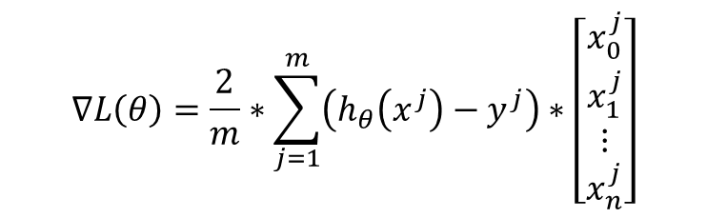
Gradient Descent for Linear Regression Loss Function
Finally
We then use the same update method:
$$∇L\left(θ\right)=\frac{2}{m}∗\sum_{j=1}^{m}{\left(h_{θ}\left(x^{j}\right)−y^{j}\right)∗\left[\begin{aligned}\begin{matrix}x_{0}^{j} \\ x_{1}^{j} \\ ⋮\end{matrix} \\ x_{n}^{j}\end{aligned}\right]}$$
$$θ= θ−α∇L\left(θ\right)$$

Slide 16
Linear Regression Coding

Slide 17
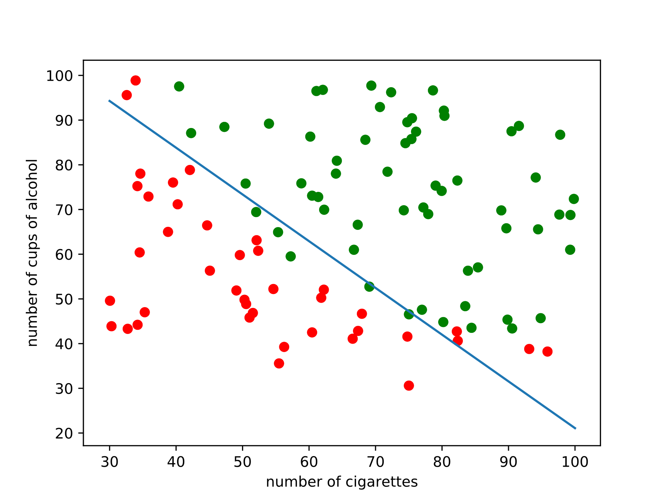

Binary Classification
Now $y∈\left\{0,1\right\}$

Slide 18

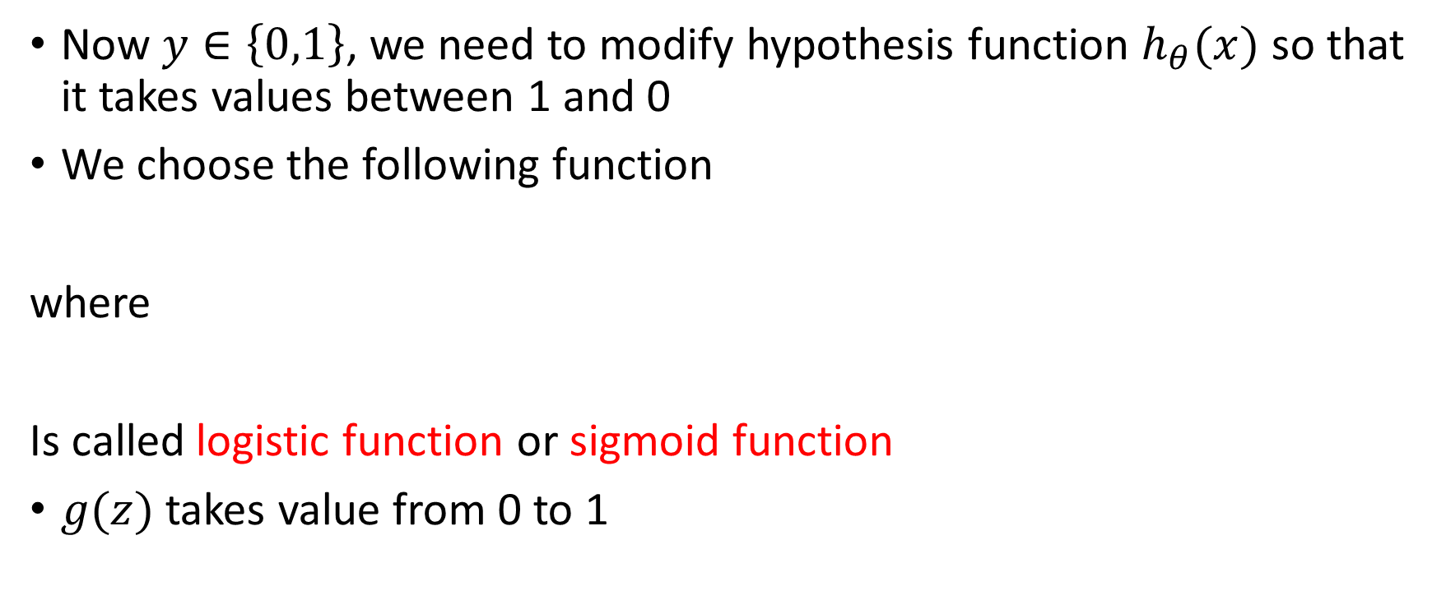

Logistic Regression
Now $y∈\left\{0,1\right\}$, we need to modify hypothesis function $h_{θ}(x)$ so that it takes values between 1 and 0
We choose the following function
where
Is called logistic function or sigmoid function
$g(z)$ takes value from 0 to 1
$$h_{θ}\left(x\right)=g\left(θ^{T}x\right)=\frac{1}{1+e^{−θ^{T}x}}$$
$$g\left(z\right)=\frac{1}{1+e^{−z}}$$

Slide 19
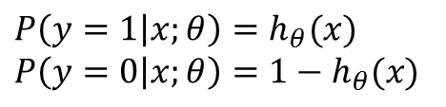
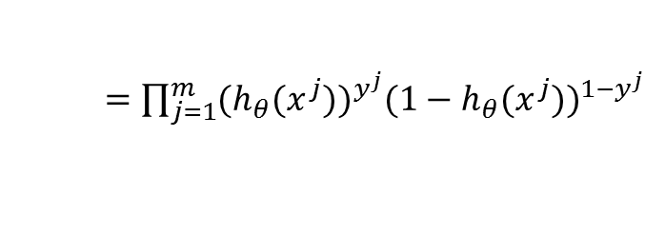
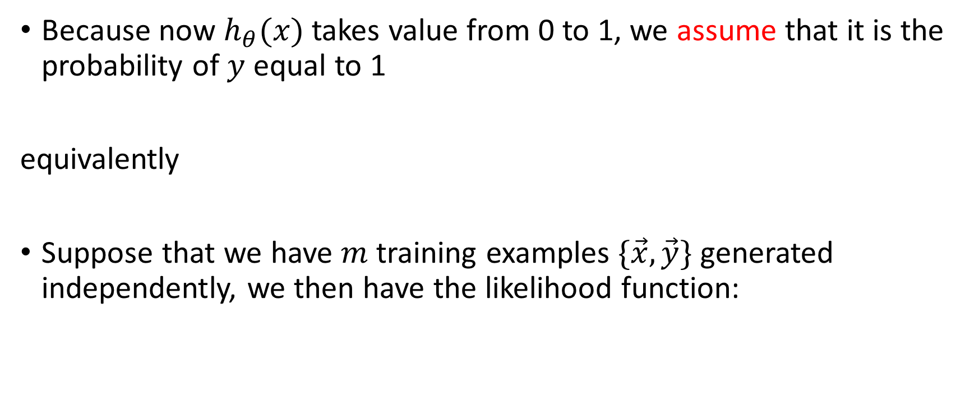
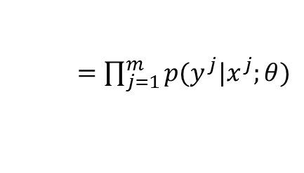


Logistic Regression
Because now $h_{θ}(x)$ takes value from 0 to 1, we assume that it is the probability of $y$ equal to 1
equivalently
Suppose that we have $m$ training examples $\{\vec{x},\vec{y}\}$ generated independently, we then have the likelihood function:
$$P\left(y=1 | x;θ\right)=h_{θ}(x)$$
$$P\left(y=0 | x;θ\right)={1−h}_{θ}(x)$$
$$p\left(y | x;θ\right)={{(h}_{θ}(x))}^{y}{({1−h}_{θ}\left(x\right))}^{1−y}$$
$$L\left(θ\right)=p(\vec{y}|\vec{x};θ)$$
$=\prod_{j=1}^{m}{p(y^{j}|x^{j};θ)}$
$=\prod_{j=1}^{m}{{(h_{θ}(x^{j}))}^{y^{j}}{({1−h}_{θ}(x^{j}))}^{{1−y}^{j}}}$

Slide 20

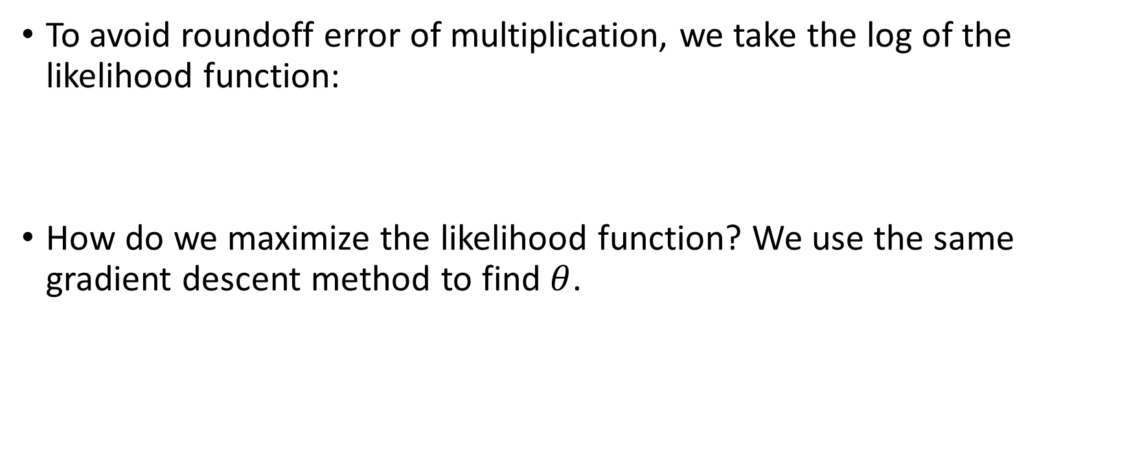
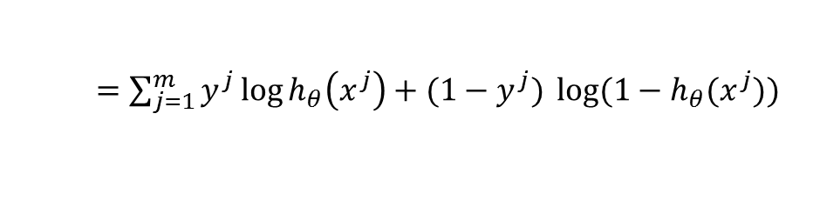
Logistic Regression
To avoid roundoff error of multiplication, we take the log of the likelihood function:
How do we maximize the likelihood function? We use the same gradient descent method to find $θ$.
$$l\left(θ\right)= L\left(θ\right)$$
$=\sum_{j=1}^{m}{y^{j}\log{h_{θ}\left(x^{j}\right)+({1−y}^{j})} \log{({1−h}_{θ}(x^{j}))} }$

Slide 21

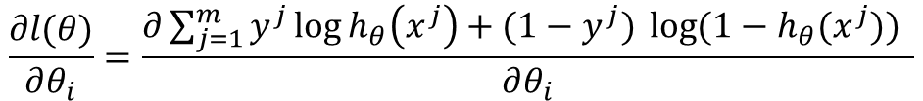
Gradient Descent of Logistic Regression
$$\frac{∂l(θ)}{∂θ_{i}}=\frac{∂\sum_{j=1}^{m}{y^{j}\log{h_{θ}\left(x^{j}\right)+({1−y}^{j})} \log{({1−h}_{θ}(x^{j}))} }}{∂θ_{i}}$$
$=\sum_{j=1}^{m}{\frac{∂\left(y^{j}\log{h_{θ}\left(x^{j}\right)+\left({1−y}^{j}\right)} \log\left({1−h}_{θ}\left(x^{j}\right)\right)\right)}{∂θ_{i}}}$
$=\sum_{j=1}^{m}{y^{j}\frac{∂\left(\log{h_{θ}\left(x^{j}\right)} \right)}{∂θ_{i}}+({1−y}^{j})\frac{∂\left(\log\left({1−h}_{θ}\left(x^{j}\right)\right)\right)}{∂θ_{i}}}$
$=\sum_{j=1}^{m}{y^{j}\frac{1}{h_{θ}\left(x^{j}\right)}\frac{∂\left(h_{θ}\left(x^{j}\right)\right)}{∂θ_{i}}+({1−y}^{j})\frac{1}{{1−h}_{θ}\left(x^{j}\right)}\frac{∂\left({1−h}_{θ}\left(x^{j}\right)\right)}{∂θ_{i}}}$
$=\sum_{j=1}^{m}{\left(y^{j}\frac{1}{h_{θ}\left(x^{j}\right)}− ({1−y}^{j})\frac{1}{{1−h}_{θ}\left(x^{j}\right)}\right)\frac{∂\left(h_{θ}\left(x^{j}\right)\right)}{∂θ_{i}}}$
$=\sum_{j=1}^{m}{\left(y^{j}\frac{1}{h_{θ}\left(x^{j}\right)}− ({1−y}^{j})\frac{1}{{1−h}_{θ}\left(x^{j}\right)}\right)\frac{∂\left(g\left(θx^{j}\right)\right)}{∂θ_{i}}}$
$=\sum_{j=1}^{m}{\left(y^{j}\frac{1}{h_{θ}\left(x^{j}\right)}− ({1−y}^{j})\frac{1}{{1−h}_{θ}\left(x^{j}\right)}\right)\frac{∂\left(g\left(θx^{j}\right)\right)}{∂(θx^{j})}\frac{∂\left(θx^{j}\right)}{∂θ_{i}}}$
$=\sum_{j=1}^{m}{\left(y^{j}\frac{1}{h_{θ}\left(x^{j}\right)}− ({1−y}^{j})\frac{1}{{1−h}_{θ}\left(x^{j}\right)}\right)\frac{∂\left(g\left(θx^{j}\right)\right)}{∂(θx^{j})}x_{i}^{j}}$

Slide 22
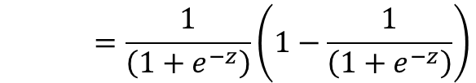

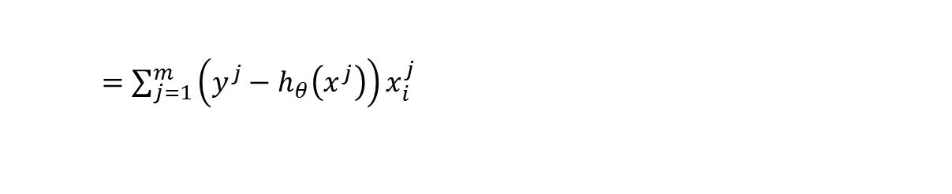
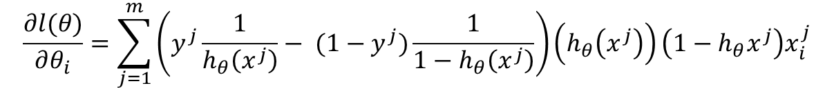

Gradient Descent of Logistic Regression
Note that
So we have
$$\frac{∂g(z)}{∂z}=\frac{1}{{\left(1+e^{−z}\right)}^{2}}e^{−z}$$
$$=\frac{1}{\left(1+e^{−z}\right)}\left(1−\frac{1}{\left(1+e^{−z}\right)}\right)$$
$$=g\left(z\right)(1−g\left(z\right))$$
$$\frac{∂l(θ)}{∂θ_{i}}=\sum_{j=1}^{m}{\left(y^{j}\frac{1}{h_{θ}\left(x^{j}\right)}− ({1−y}^{j})\frac{1}{{1−h}_{θ}\left(x^{j}\right)}\right)\left(h_{θ}\left(x^{j}\right)\right)\left({1−h}_{θ}x^{j}\right)x_{i}^{j}}$$
$=\sum_{j=1}^{m}{\left(y^{j}−h_{θ}\left(x^{j}\right)\right)x_{i}^{j}}$

Slide 23
Logistic Regression Coding

Slide 24
Logistic Regression

Slide 25
Limitation of Logistic Regression

Slide 26
Neural Networks

Slide 27
Next Class: Neural Networks Basics

